Slide 1
We have been discussing phases and phase
Changes
These changes reflect thermodynamic minima;
i.e. as you move across a phase diagram, changes
are observed to occur because these are the most
stabile species that exist under those conditions
But, can these changes occur at a reasonable rate?

Slide 2
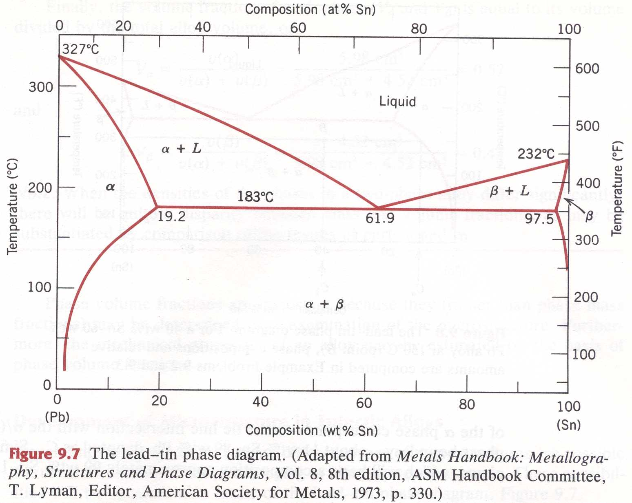
We have been discussing phases and phase
Changes
These changes reflect thermodynamic minima;
Phases
Dictated by
ΔG at various
states

Slide 3
We have been discussing phases and phase
Changes
These changes reflect thermodynamic minima;
i.e. as you move across a phase diagram, changes
are observed to occur because these are the most
stabile species that exist under those conditions
But, can these changes occur at a reasonable rate?
Today we’ll discuss diffusion in alloys and related
systems

Slide 4
Phase Diagrams - [Callister Ch. 10]
Diffusion - [Callister Ch. 6]
Energetics vs. Kinetics
  Energetics described by Phase Diagrams
    Represents the lowest energy at a given set of thermodynamic variables
      p, T, V, n
    F=ΔE/Δx – the driving force to reach equilibrium
  Kinetics – e.g., Diffusion remember pathways
    The process at which equilibrium is reached
    Fast kinetics – Equilibrium is easily formed
    Slow kinetics – Equilibrium difficult to reach
      Metastable Phases

Slide 5
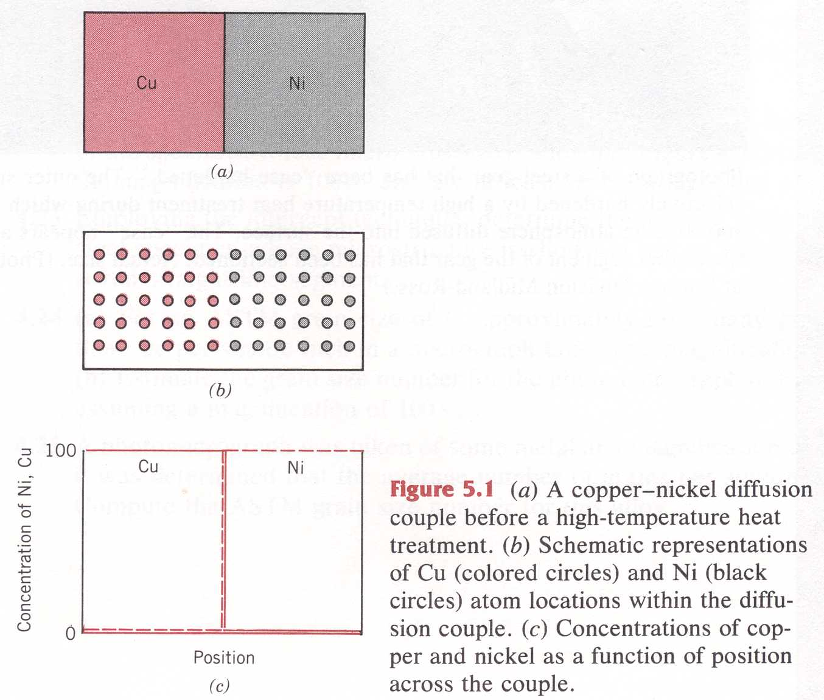
Diffusion
Lowering of the Energy due to Entropy Effects
  Configurational Entropy (or Entropy of Mixing)
  Alloying
    Cu mixed into Ni
    Ni mixed into Cu
  Transport of Chemical Species
    Diffusion

Slide 6
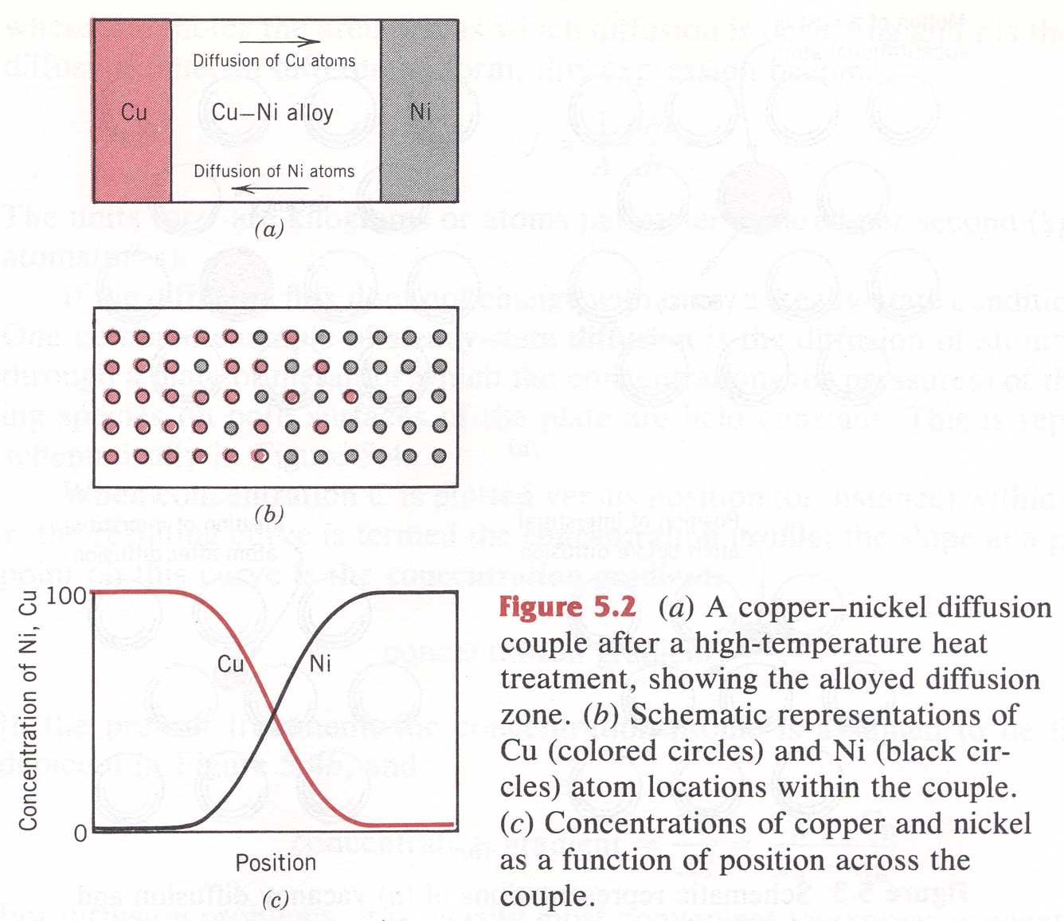
Diffusion
Transport of Chemical Species
  Diffusion Couple Cu - Ni
    Diffusion of Cu
    Diffusion of Ni
  Change in Concentration of both Cu and Ni
    From High Concentration to Low Concentration
  Mechanism?

Slide 7
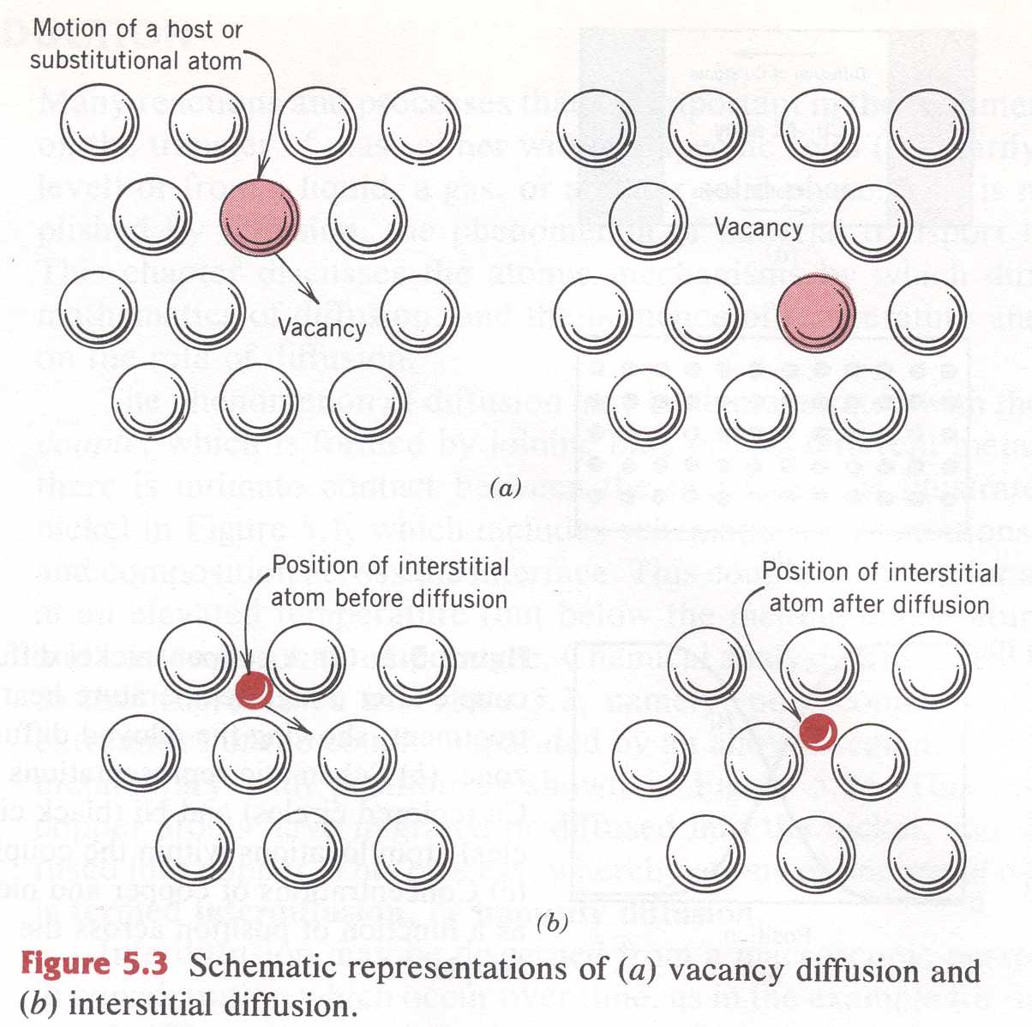
Diffusion
Vacancy Diffusion Mechanism
Interstitial Diffusion Mechanism

Slide 8
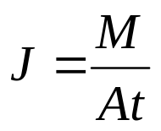
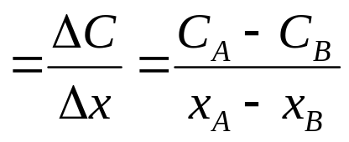
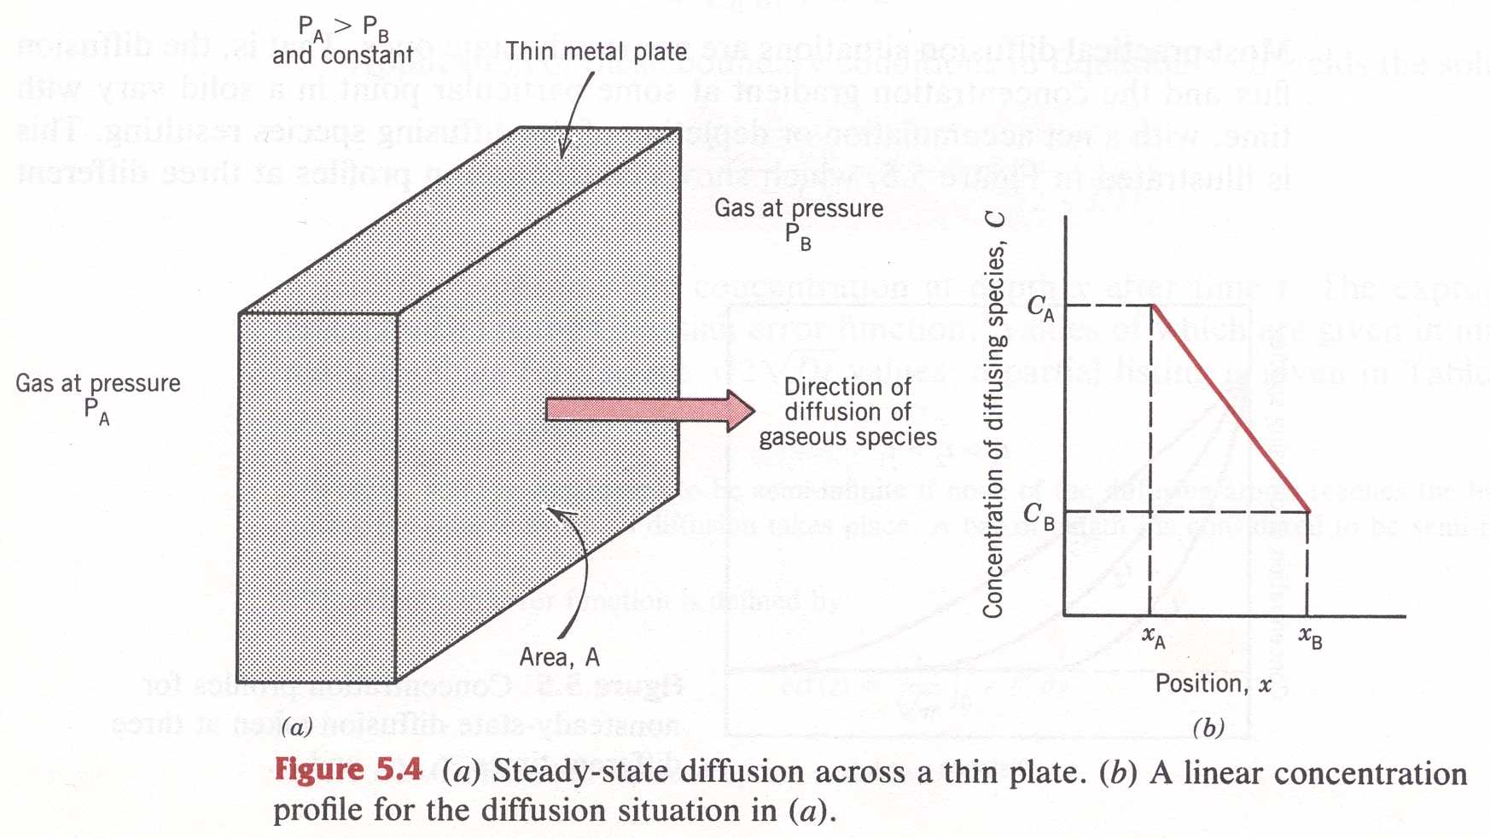
Diffusion
Diffusion Flux – J: Consider a gas flowing through a membrane
  M = mass
  A = Area
  t = time
Eq. (5.1a)
Concentration Gradient
C = mass per unit volume
Callister
Fig. 5.4

Slide 9
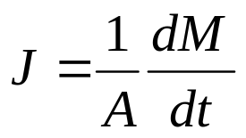
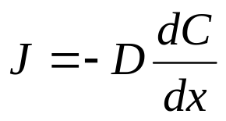
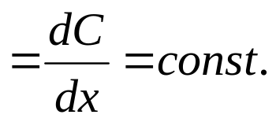
Diffusion
Steady State:
  Flux is constant in time (ex. Gas through a membrane)
    proportional to the Concentration Gradient
  Concentrations are invariant – Concentration gradient = const.
    M = mass
    A = Area
    t = time
Eq. (5.1b)
Eq. (5.3)
Fick’s First Law
D = Diffusion Coefficient
Concentration Gradient

Slide 10
Diffusion
Steady State:
  Flux is constant in time
    proportional to the Concentration Gradient
  Concentrations are invariant – Concentration gradient = const.
    M = mass
    A = Area
    t = time
Flux = kinetics x constant
Eq. (5.1b)
Eq. (5.3)
Fick’s First Law
D = Diffusion Coefficient
Concentration Gradient
Callister
Fig. 5.4

Slide 11
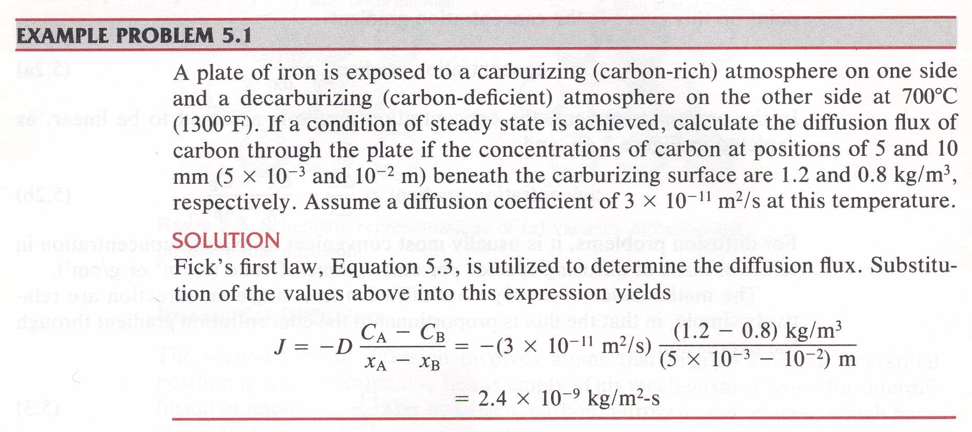
Diffusion
Example Problem 5.1
Eq. (5.3)
D = Diffusion Coefficient [m²/s]

Slide 12
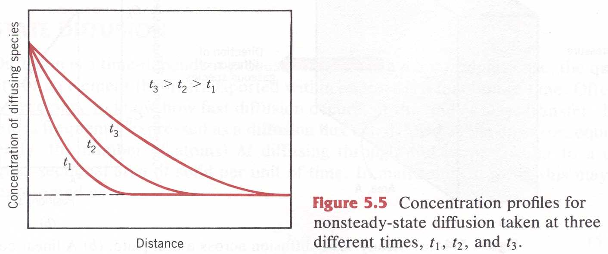
Diffusion
Most diffusions are
Non-steady state…
The concentration gradient
In a soda bottle changes
Mixing of alloys goes to
completion
Nonsteady-State Diffusion
  Concentration gradient changes in time

Slide 13
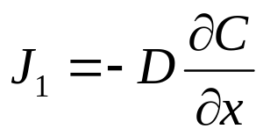
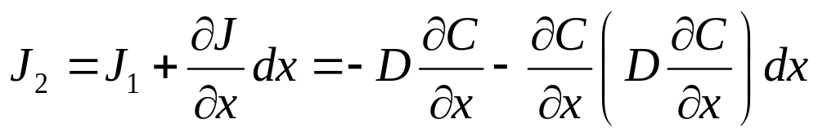
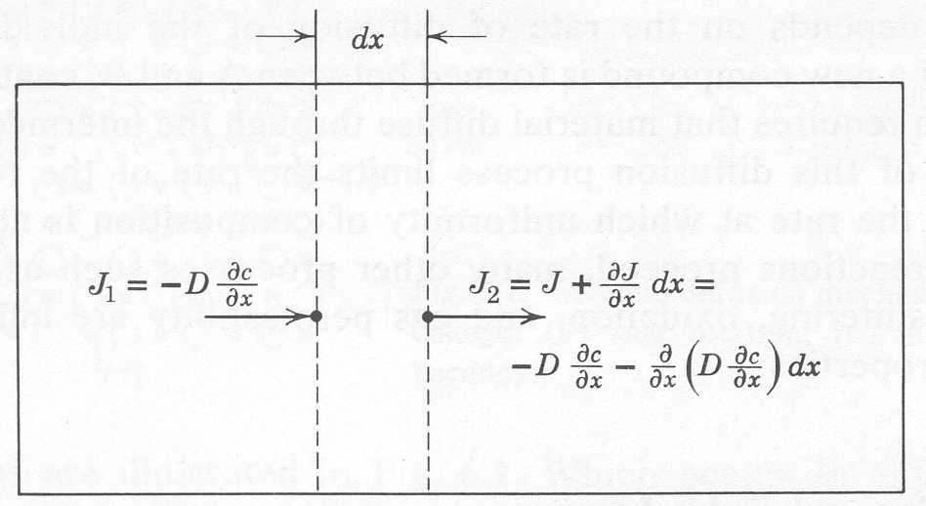
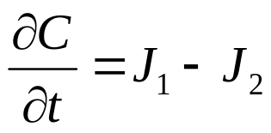
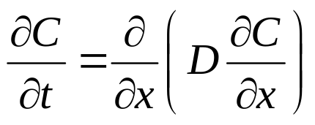
Diffusion
Nonsteady-State Diffusion
  Conservation of Mass
    Plane 1:
    Plane 2:
Flux = initial flux + change of
Flux with distance
Flux = diff const
Times gradient
Fick’s Second Law

Slide 14
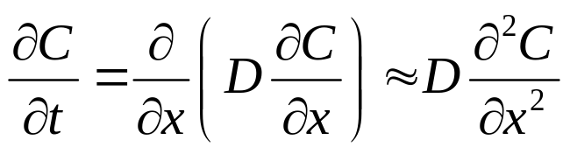
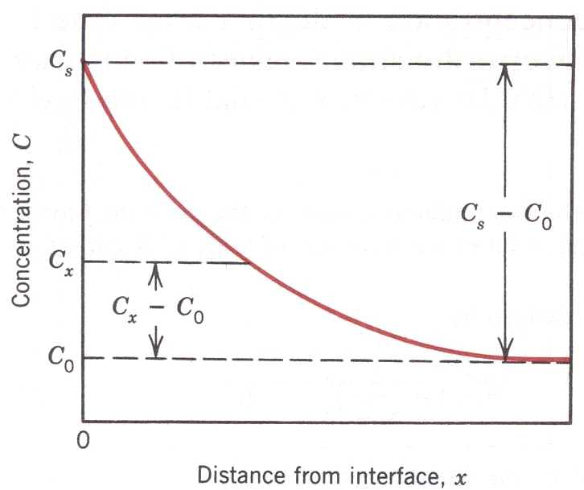
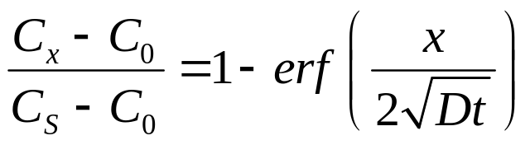
Diffusion
You can calculate the diffusion
Nonsteady-State Diffusion
  The Diffusivity is approximately constant
  Solution depends on Boundary Conditions
  Consider a semi-infinite solid – Surface Concentration = C_{S}
    Initial Concentration = C₀
    x = 0 at the surface
    t = 0 the instant before the diffusion process begins
  Solution: The Concentration at depth
  x is determined by
  erf = the error function

Slide 15
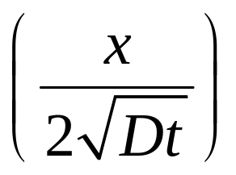
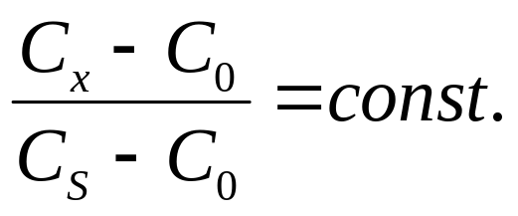
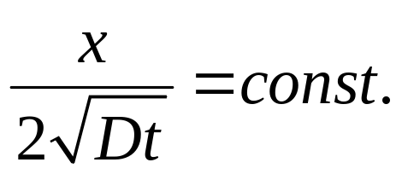
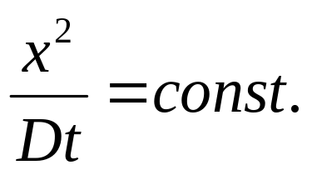
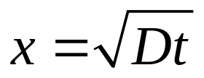
Diffusion
Nonsteady-State Diffusion
  Dimensionless parameter
  To obtain a specific concentration
  Obtained for
    or
  Characteristic Diffusion Length
  Distance of diffusion depends on distance and time

Slide 16
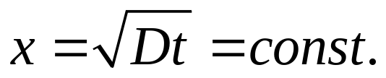
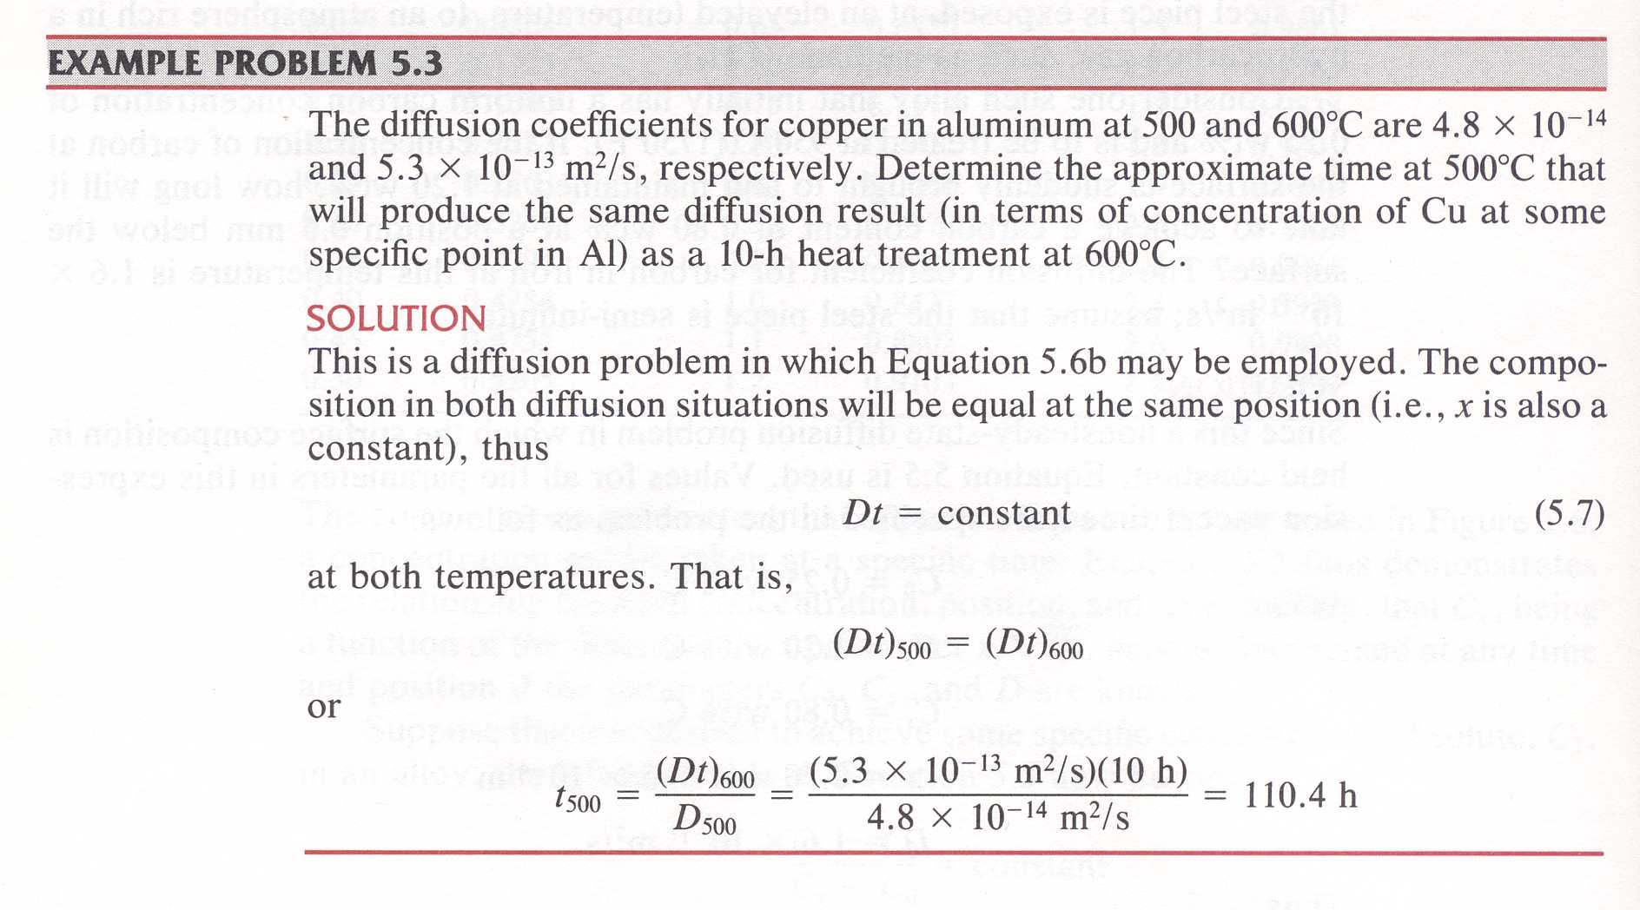
Diffusion
Callister – Example Problem 5.3

Slide 17
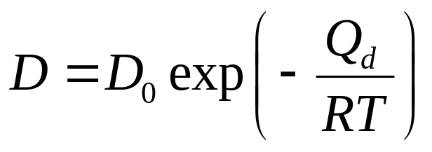
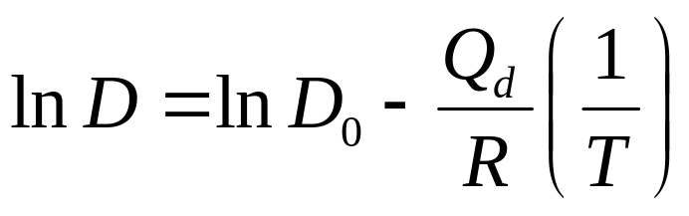
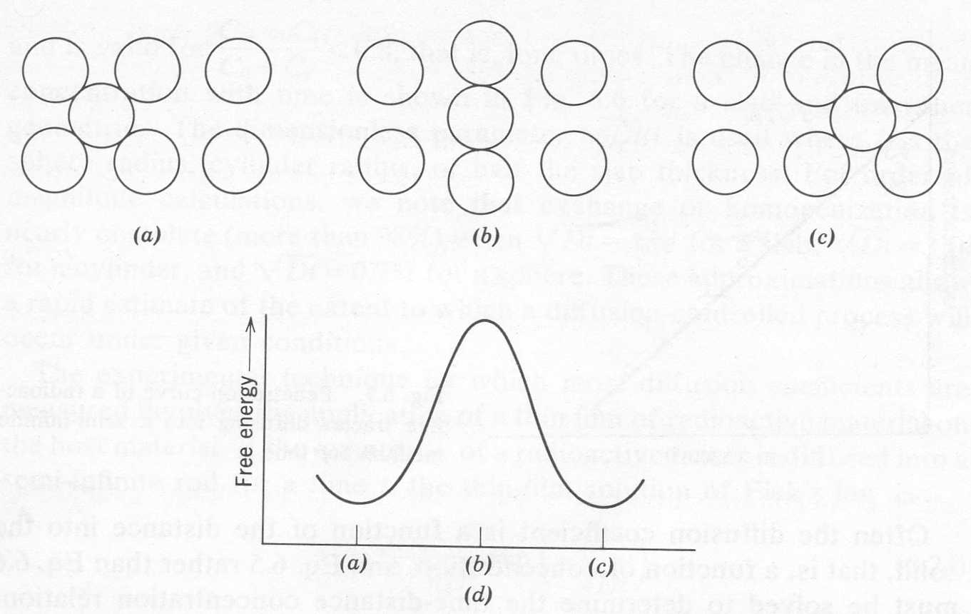
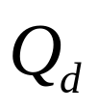
Diffusion
Diffusion
  Thermal Activation
Energy
Barrier is
Forcing itself
through

Slide 18
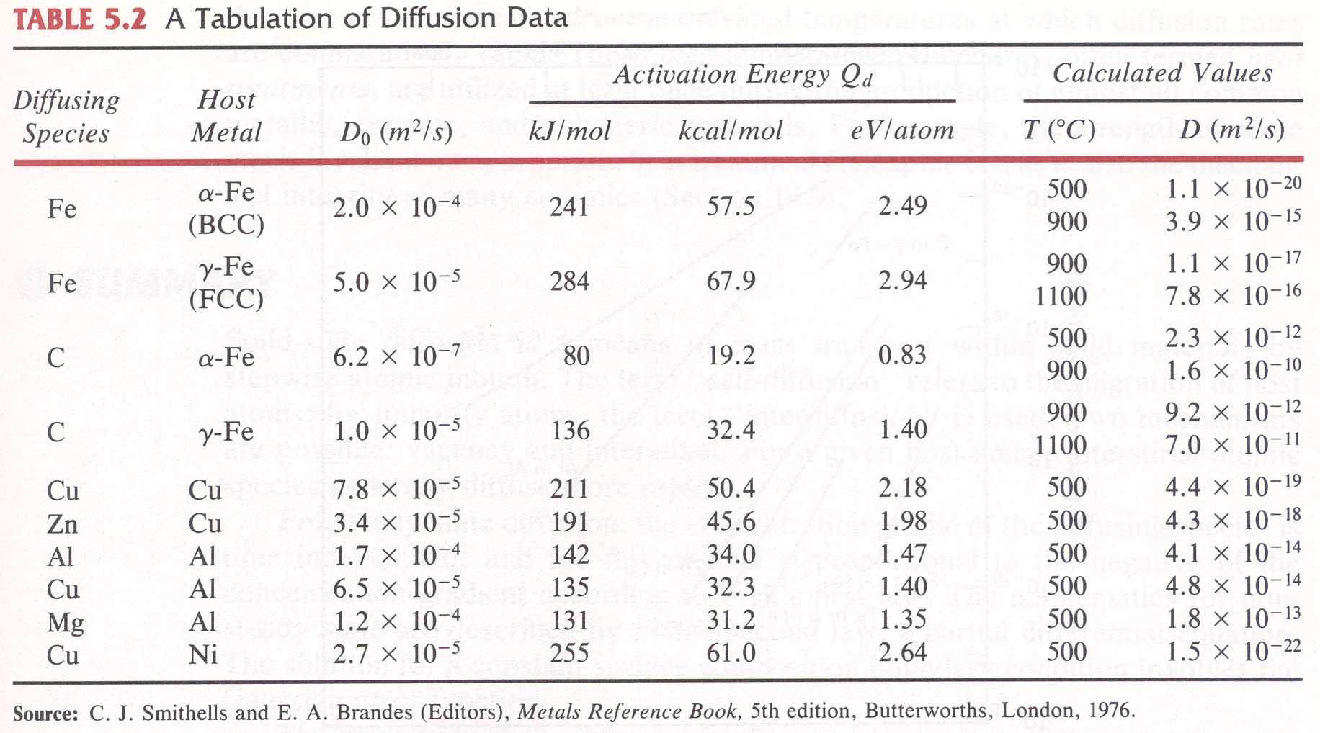
Diffusion
Diffusion
  Thermal Activation

Slide 19
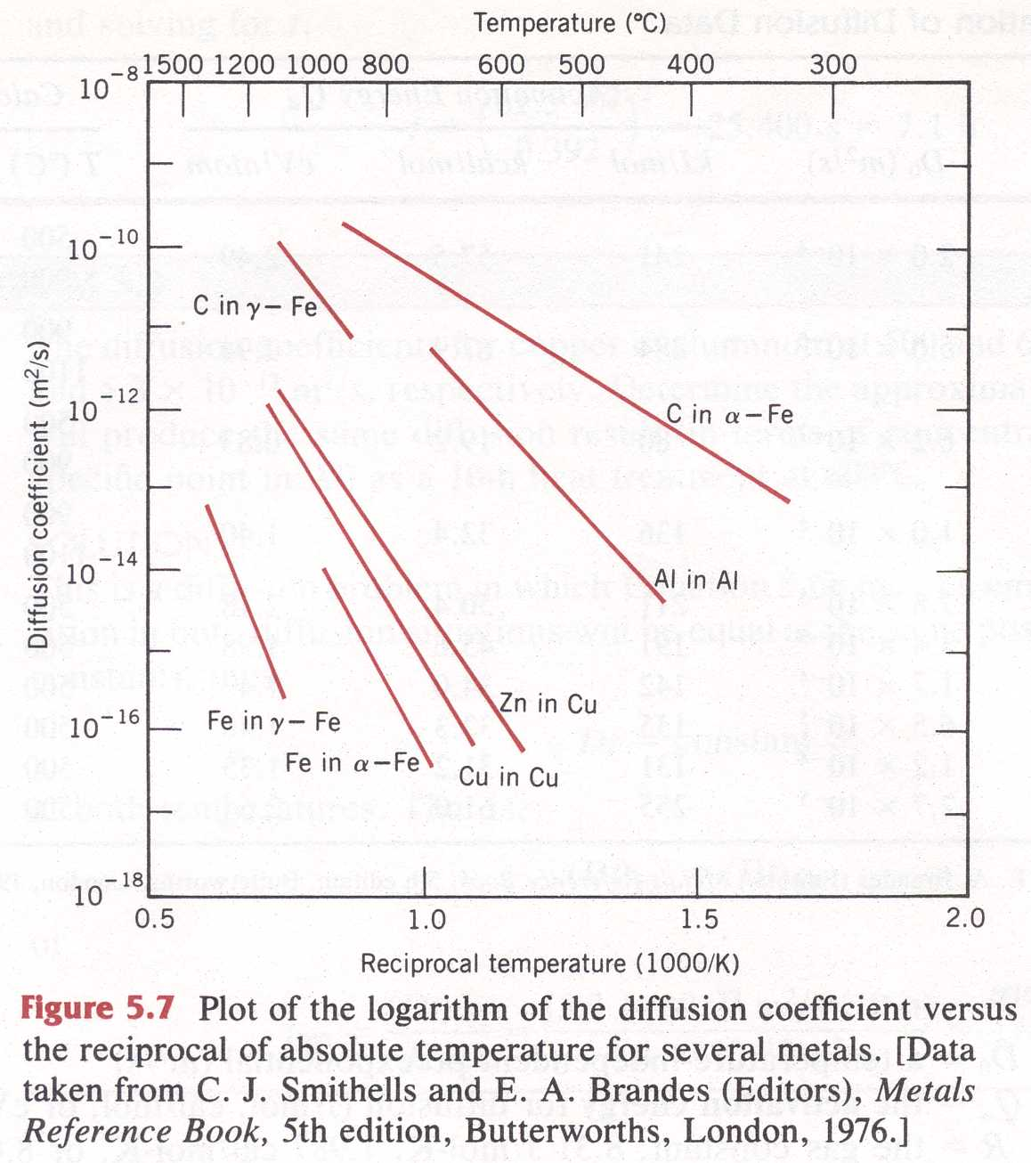
Diffusion
Diffusion
  Thermal Activation

Slide 20
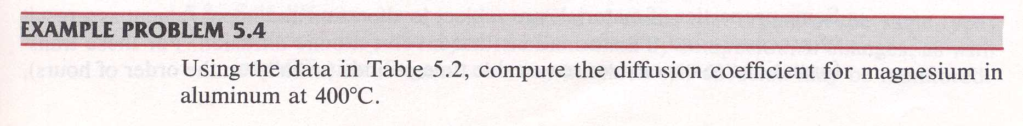
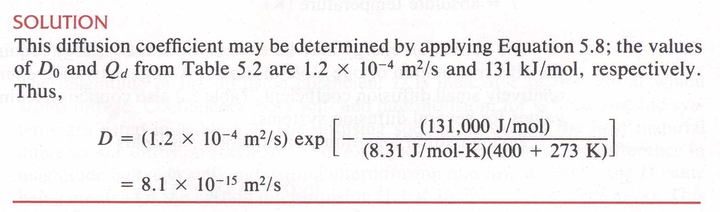
Diffusion
Callister – Example Problem 5.4
Work this one yourself at home

Slide 21
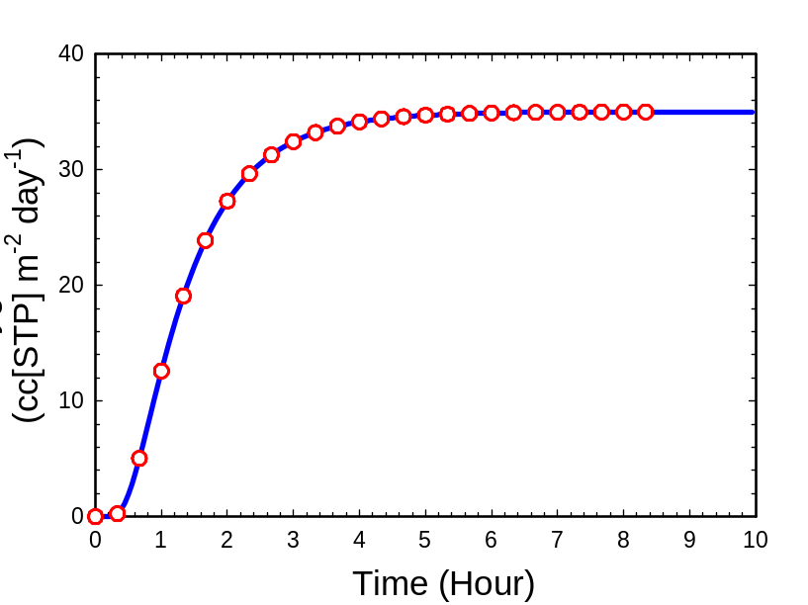
Diffusion
Permeability
Diffusivity

Slide 22
The Physics of Diffusion
The process of gas permeation through a material of finite thickness involves three different steps:
Gas molecule dissolves in the material at one surface
Dissolved gas molecule diffuses through the material
Diffusing gas molecule desorbs at the other surface
Gas permeation

Slide 23
The Physics of Diffusion
P = D ·S
Diffusivity, D --- a kinetic parameter describing the mobility of the gas molecules in the polymer;
Solubility, S --- a thermodynamic parameter describing the ability of the polymer to dissolve the gas;
Permeability, P --- the product of D and S, determining the steady state gas flux.

Slide 24
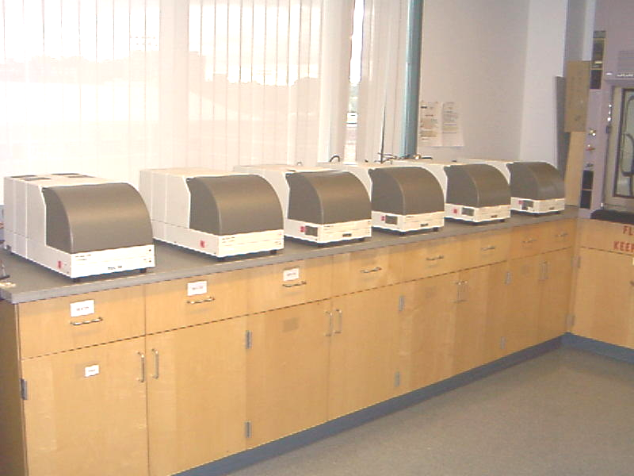
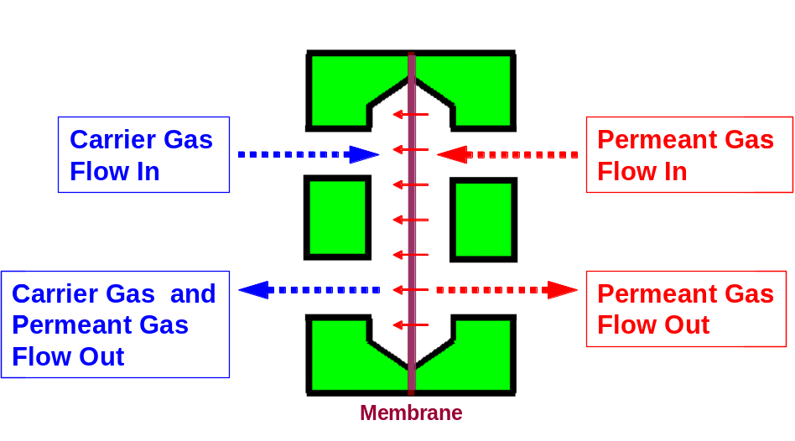
The Physics of Diffusion
Testing Facility – Baer/Hiltner Group

Slide 25
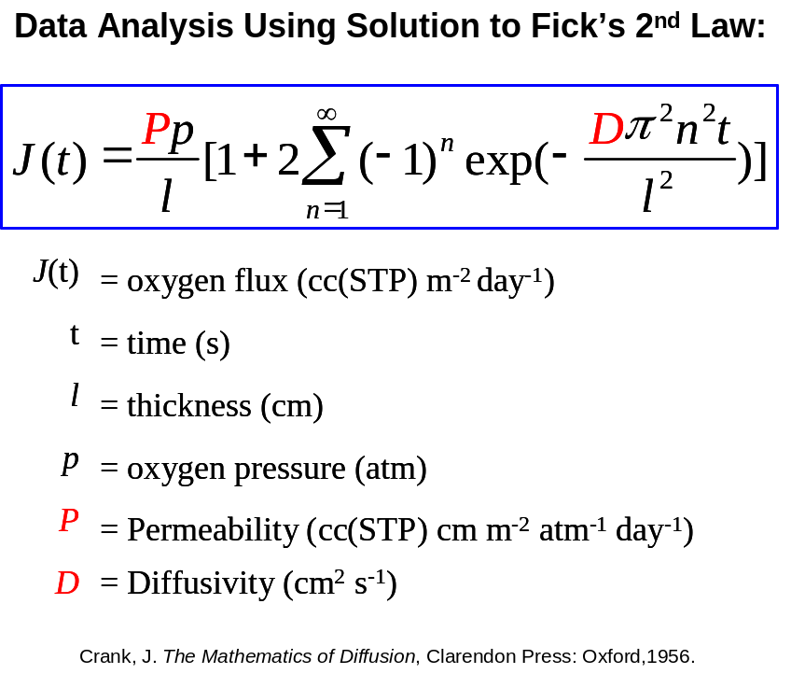
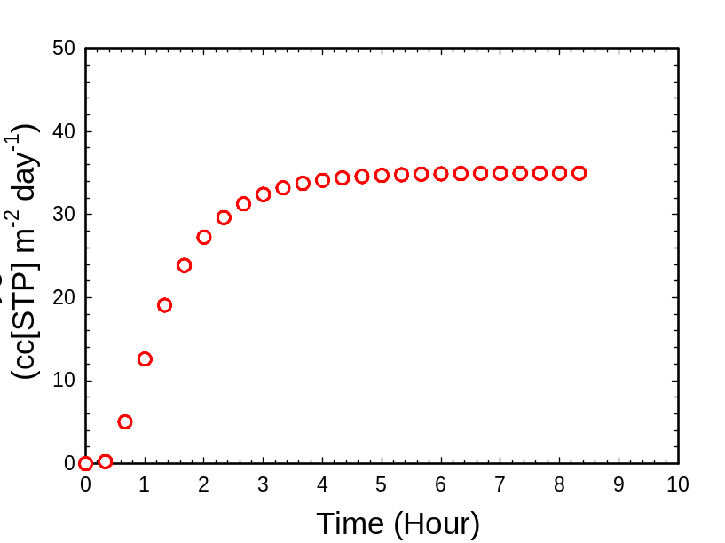
The Physics of Diffusion
Plateau determines permeation (t becomes big, second term→small)
The effect of t on J will be proportional to D at small t values
Slope determines diffusivity
P=D x S or S = P/D

Slide 26
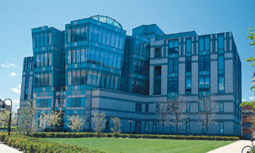

Oxygen Permeation in Polyesters –
i. Amorphous Barrier
An example:
One can replace terephthalate with
isophthalate in the polyester backbone
Tg ρ P D S
PET 81 1.335 0.469 5.6 0.098
PET/10%I 80 1.337 0.398 4.7 0.098
PEI 68 1.351 0.099 1.6 0.072
Schiraldi Research Group

Slide 27
Oxygen Permeation in Polyesters –
i. Amorphous Barrier
An example:
What was found here is that S (solubility) tracks with
Polymer density, and D (diffusivity) tracks with the
Ability of the polymer chains to rotate like a turnstile
One can replace terephthalate with
isophthalate in the polyester backbone
Tg ρ P D S
PET 81 1.335 0.469 5.6 0.098
PET/10%I 80 1.337 0.398 4.7 0.098
PEI 68 1.351 0.099 1.6 0.072
Schiraldi Research Group

